Slide 1
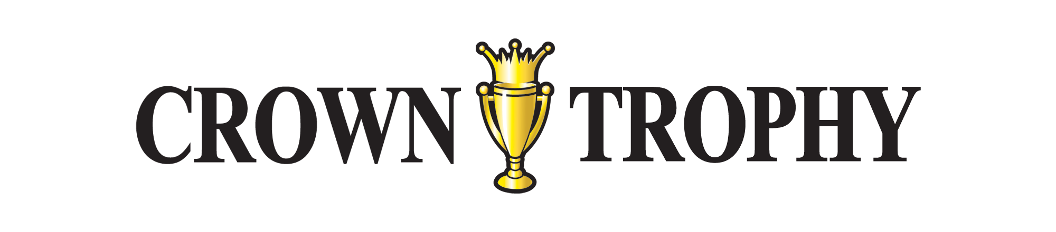
Preparing Artwork
for Apparel

Slide 2
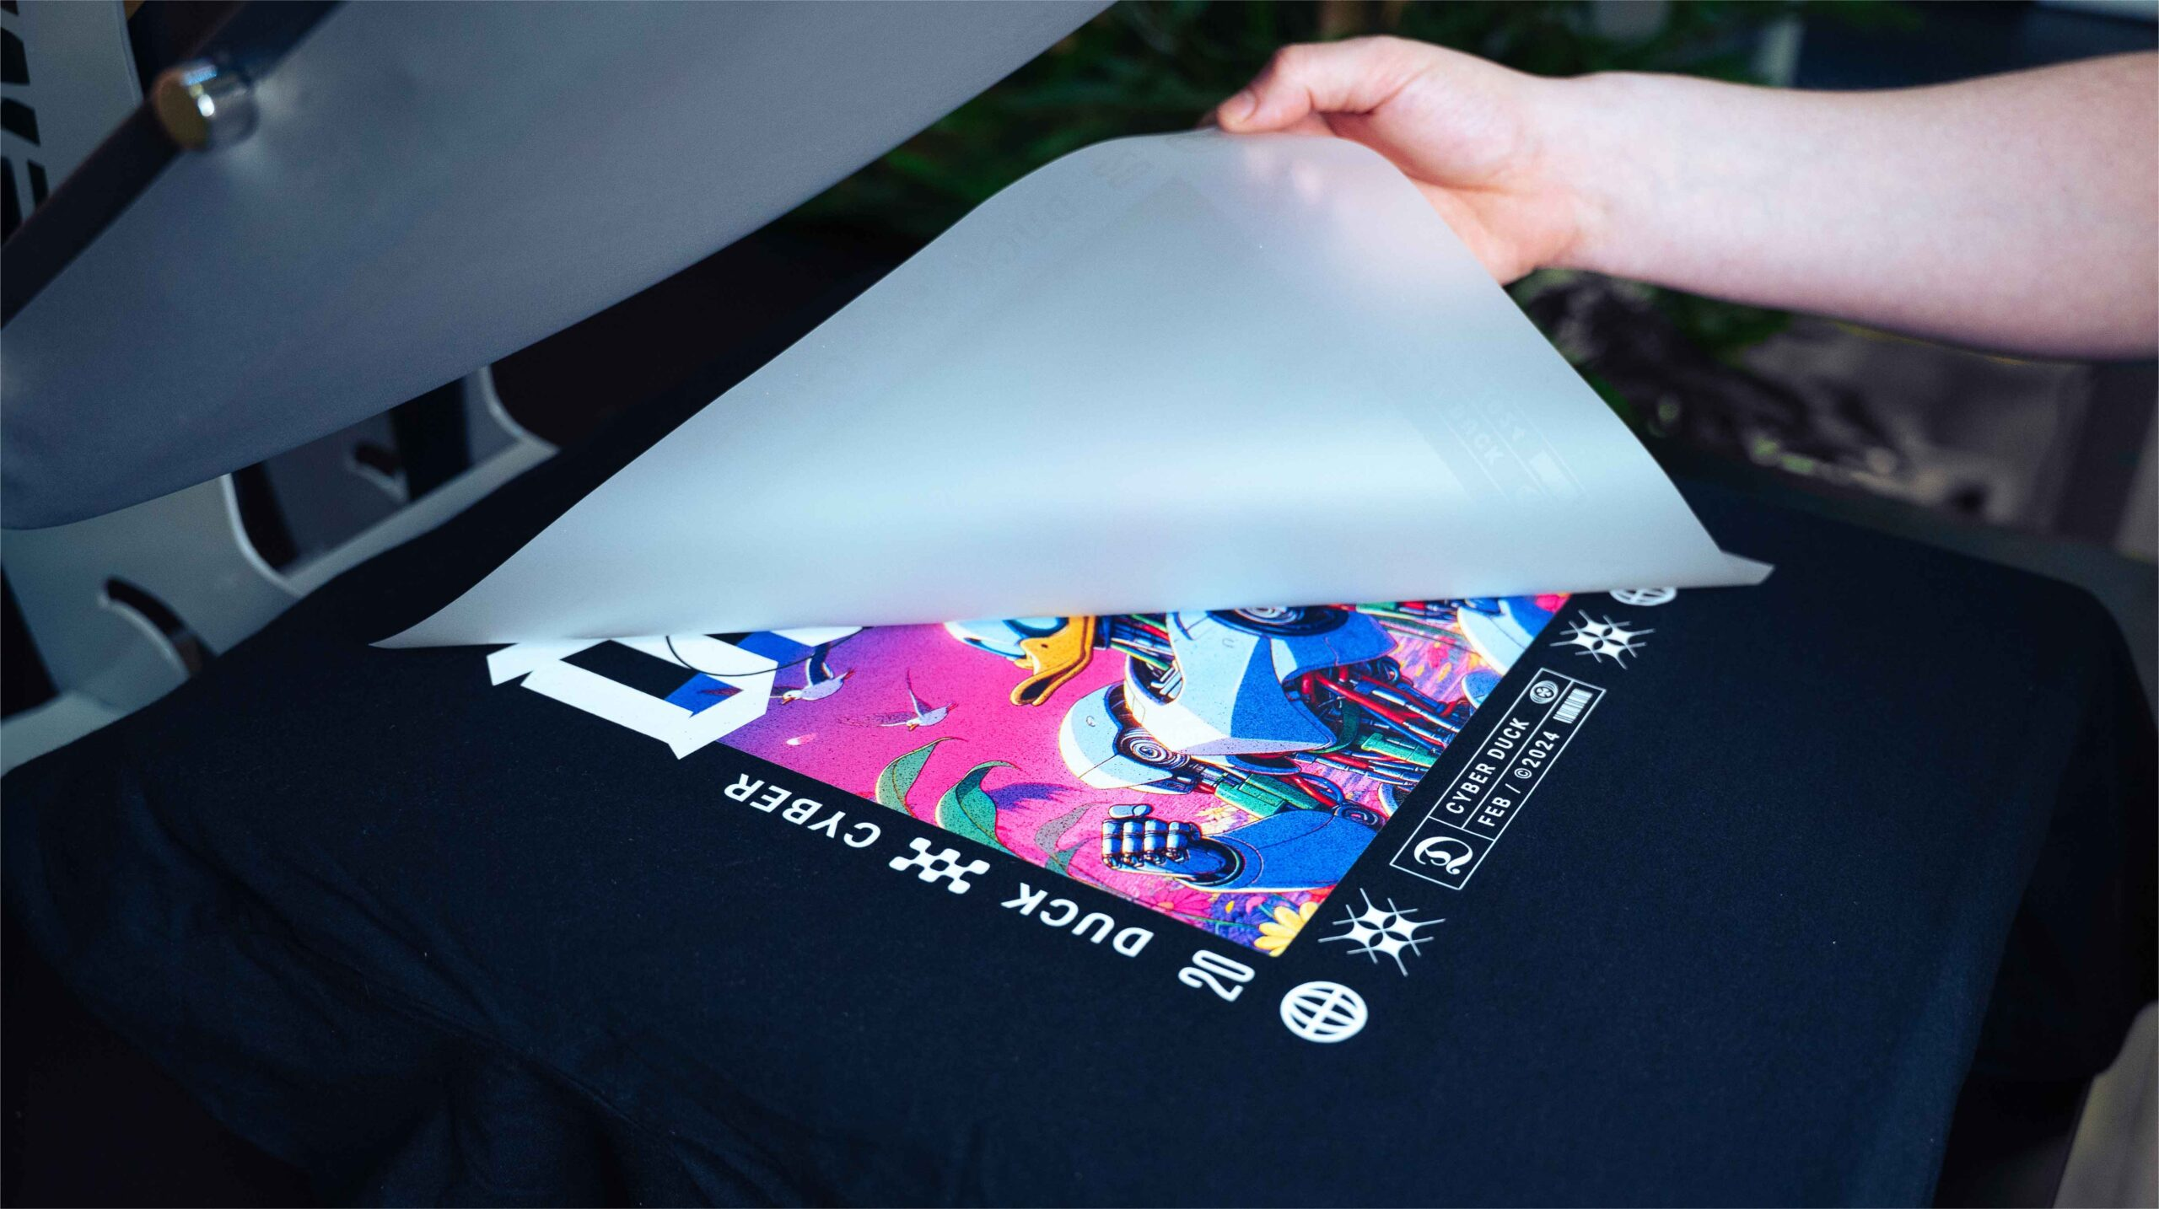
Artwork Preparation
Color Profiles and Resolution
CMYK color mode is the standard for printing.
RGB color mode is best for screens, not print.
Size: Create artwork at the size needed for the final product.
Resolution: 300 PPI is the minimum for the sharpest and best quality.
Transparent Backgrounds: Use PNG files for standard quality and lower file sizes.

Slide 3
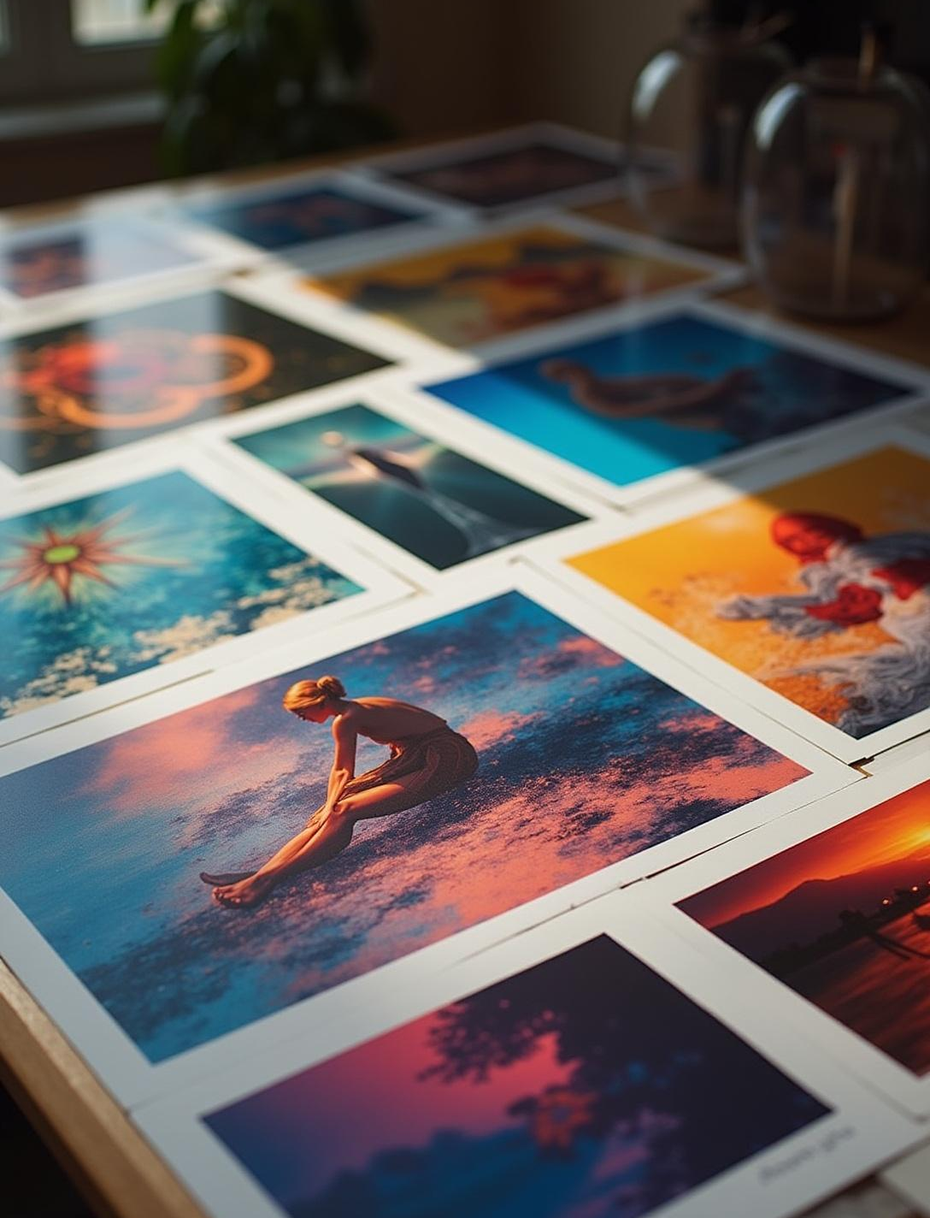
Artwork Preparation
Recomended File Formats and Compatibility
Vector Graphics: EPS, AI, SVG, PDF, & CDR
can be scaled without loss of quality or color.
High-Resolution Raster Images: PNG, TIFF,
and PSD are accepted with a minimum
of 300 PPI.
Image Editing Software like Coreldraw, Adobe Illustrator or Photoshop allow you to adjust and export any artwork.

Slide 4
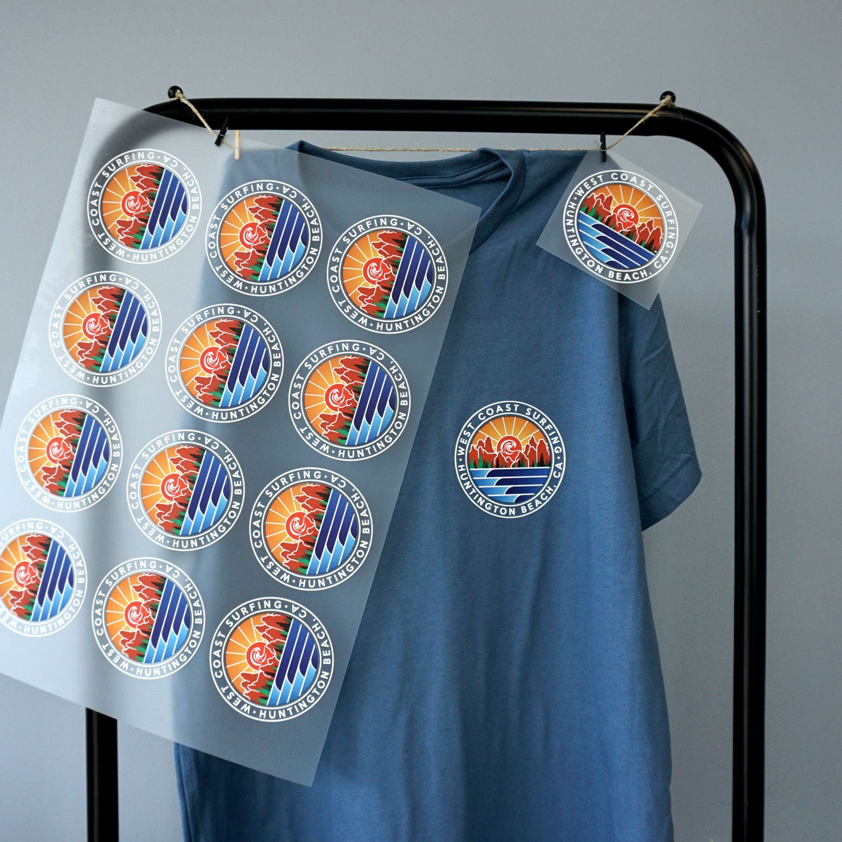
Printing Process
Direct To Film Transfers
Sending Out For Film:
Upload: your final artwork to Ninja Transfers, Coldesi, Crown Jacksonville(FL) or Crown Hurst (TX)
Creating Your Own Film:
RIP (Raster Image Processor) is specialized software that acts as an interpreter between your design file and the printing device.
Gang Printing enables multiple designs to be printed simultaneously on one sheet, saving time and costs
of material.
Cutting & Spacing: Gang designs must be properly spaced for separation and cutting.

